Slide 1
Climate Change and Climate Justice
Does climate change impact everyone equally?

Slide 2

Weather and climate – What is the weather?
The weather describes what is happening in the atmosphere over the next few hours or days. When we describe the weather, we might talk about sunshine, temperature, wind and precipitation (rain, hail, snow).

Slide 3
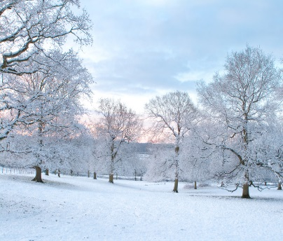
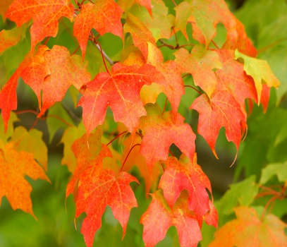
Weather and climate – What is the climate?
The climate refers to the average weather you would expect in a particular area over a long period of time (months, years, centuries).

Slide 4
Weather and climate
Our weather can change from day to day, but our climate is usually constant.
How would you describe the climate in Ireland during the following months?
January and February
July and August

Slide 5
The Carbon Cycle
Climate is affected by the amount of Carbon Dioxide (CO₂) in the atmosphere.
Check out our animation on the Trócaire Lent 2015 microsite to help understand the Carbon Cycle and Greenhouse Effect.
Take notes to help you remember key points!
Can you create a poster that explains the Carbon Cycle and/or the Greenhouse Effect?

Slide 6
Recap on animation
Carbon Dioxide (CO2) in the atmosphere traps heat from the sun
This is why CO2 is called a greenhouse gas. It creates a blanket of warmth, known as the greenhouse effect that keeps the earth from freezing
The more CO2 in the atmosphere, the warmer the earth becomes
The amount of CO2 in the atmosphere over the last 8,000 years has been stable, creating suitable conditions for human beings to thrive

Slide 7
Recap on animation
The amount of CO₂ in our atmosphere has changed remarkably over the last 200 years
Population growth, industrialisation, mass transport and the increasing use of electricity has led to massive demand for fossil fuels (Coal, Oil, Natural Gas)
Burning fossil fuels leads to the release of CO₂ into the atmosphere
Increasing amounts of CO₂ lead to increasing temperatures, triggering changes in the earth’s climate
Research activity: The use of ‘Fracking’ to extract shale gas from the ground has caused serious concerns to be raised. Conduct some research into this process and outline the arguments for and against ‘Fracking’!

Slide 8
Changing Global Temperatures
By the year 2012, the average global temperature was already 0.85°C higher than pre-industrial times!
Scientists predict that by 2100, average global temperatures could be almost 5°C higher than today. This would be catastrophic for the planet.
The United Nations believes that temperatures need to be limited to a rise of no more than a 2°C increase on pre-industrial levels (1750) in order to try and limit the impact of climate change.
Notes:
IPCC AR5, working group 1 http://www.ipcc.ch/index.htm
IPCC AR5, working group 3 http://www.ipcc.ch/index.htm

Slide 9

  Climate change could affect different parts of the world in different ways.
  Scientists have identified some of the likely effects of climate change.
  Click on the buttons to find out more.
Flooding
Temperature
Sea level
Trócaire works with local organisations to support poor communities in over 17 countries worldwide. Some of them are already dealing with the effects of climate change.
Sea level
Drought
Drought
Storms
Storms
Deforestation
Flooding
⊠ back to main menu
Temperature
Click here once you have visited all five slides

Slide 10

  Flooding may increase in some areas.
  More intense and unpredictable rainfall could produce more flash floods. In coastal areas
  flooding could occur due to more frequent
  storms and higher sea levels.
Temperature
Sea level
Drought
  Flooding affects lives - washing away homes, schools and even people. People also need clean, fresh water to live. If flood water contaminates the drinking water supply many people can get sick.
Storms
Flooding
⊠ back to main menu

Slide 11
Scientists say sea levels could rise as a
result of climate change. There are two
reasons why this could happen.
1. As the water in the oceans warms, it
expands and takes up more space.
2. Ice from the polar caps and from glaciers
is melting, adding more water to the seas.
Temperature
Sea level
Drought
People living on small, low-lying islands may have
to evacuate and millions of people in low-lying
areas will be at risk of flooding.
Storms
  Salt from rising sea levels could pollute ground water making it undrinkable and more difficult to grow crops.
  A 1.5m sea level rise is predicted to displace 34m people in Bangladesh by the year 2030.
Flooding
⊠ back to main menu

Slide 12
  Droughts are likely to be more frequent and more intense.
  This could mean water shortages for up to
  five billion people and food shortages for
  250 million people.*
  *Source: Stern Review on the economics of climate change, 2006.
Temperature
In some areas there will be less water available for drinking and to water crops because there
will be less rain.
Sea level
Drought
Storms
Flooding
⊠ back to main menu

Slide 13
  Intense storms, know as hurricanes, cyclones and typhoons (depending on where they occur in the world) could happen much more often
  and be more intense as a result of
  rising sea surface temperature.
Temperature
Sea level
Drought
Storms can be devastating to the
lives of people living in the affected
area; with damage to homes and
schools and loss of lives.
Storms
Flooding
⊠ back to main menu

Slide 14
  Experts agree that temperature rises must be below a rise of 2°C to help limit dangerous climate change.
Temperature
The earth is getting hotter –
eleven of the last twelve years
have been the hottest
since records started in 1850.
Sea level
Drought
Storms
Flooding
⊠ back to main menu
Notes:
3 The Royal Society, Climate Change controversies: a simple guide; available at
http://www.royalsoc.ac.uk (accessed June 19 2007)

Slide 15
How might climate change affect Ireland?
Climate Change is having different effects in different parts of the world.
It is likely that due to climate change, Ireland will experience an increase in severe weather events such as:
Storms
Floods
Hotter, drier summers
Colder, wetter winters
Activity: Can you find any evidence in newspapers or on the internet to suggest that this is already happening?

Slide 16
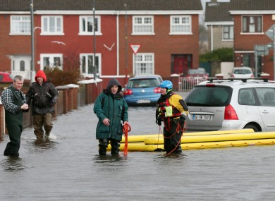
Ireland has seen more storms, droughts and floods than ever before. Has your local area been affected?
Did you know? The fodder (food for livestock) crisis of 2012/2013
cost Irish agriculture an estimated 500 million euros!

Slide 17
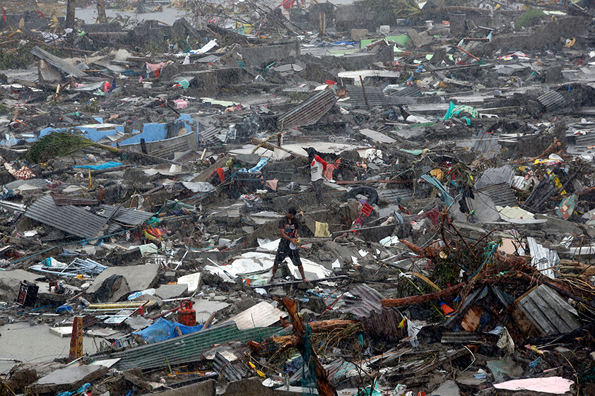
Every country around our world is feeling the impacts of climate change. But some people are feeling it more than others.
Destruction caused by Typhoon Haiyan in the Philippines, 8th November 2013.
Many climatologists (scientists who study long term weather trends) now link the increasing intensity of storms like Typhoon Haiyan to climate change.

Slide 18
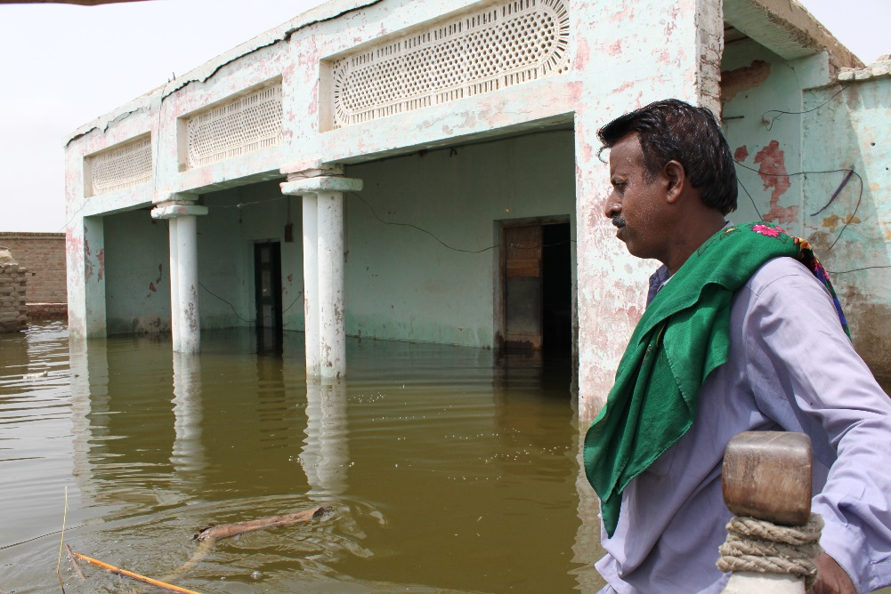
Every country around our world is feeling the impacts of climate change. But some people are feeling it more than others.
A common sight during the 2010 floods in Pakistan that affected over 18 million people and resulted in the deaths of almost 2,000 people.
150,000 deaths globally are currently linked to climate change every year.

Slide 19
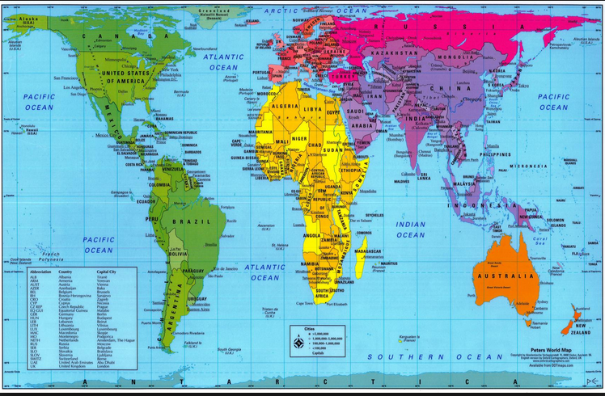
Can you find Ireland, Pakistan, The Philippines and Ethiopia on the map?
Ireland
Pakistan
Ethiopia
The Philippines
Sub-Saharan Africa is an area at very high risk from climate change

Slide 20
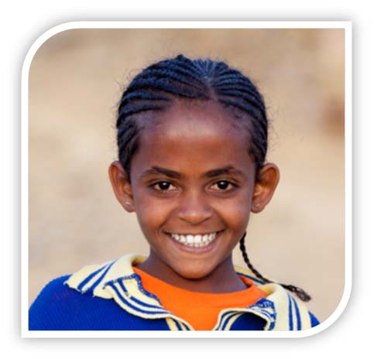
Meet Mahlet. She is 13 years old. Her community in northern Ethiopia will be the focus community for our 2015 Lent campaign.

Slide 21
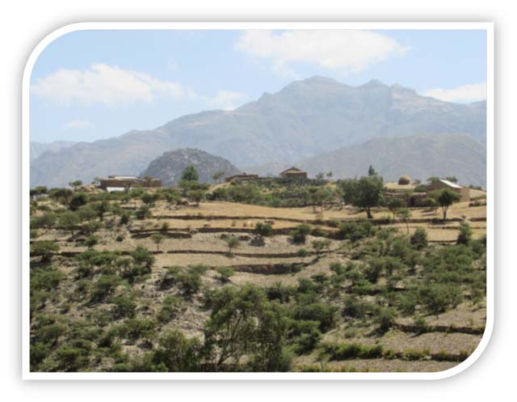
Mahlet lives in a rural community in the region of Tigray in northern Ethiopia.
Mahlet’s house

Slide 22
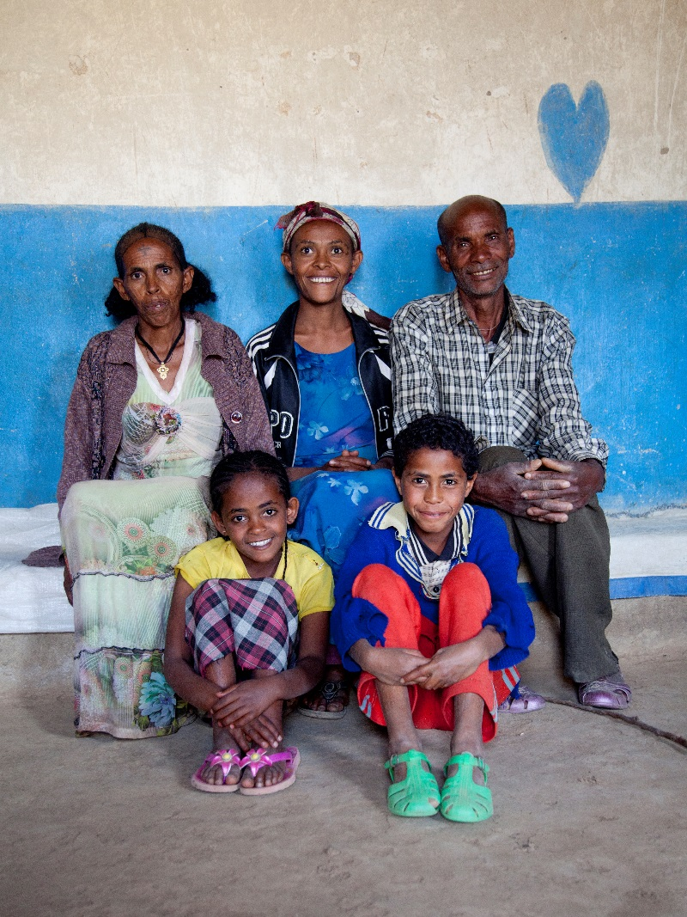
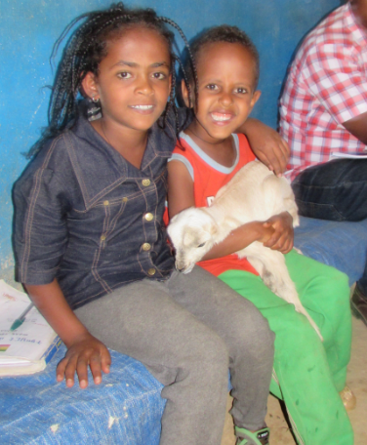
Mahlet lives with her mum and dad, sister, two brothers and nephew.
Shewit
Urkabel
Taemu
Ali
Mahlet
Samuel

Slide 23
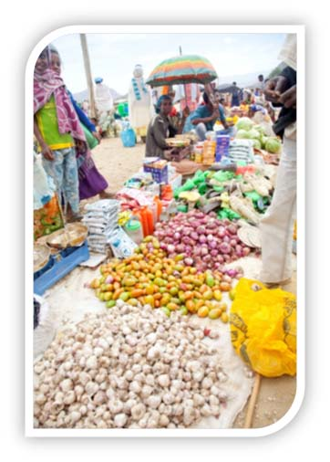
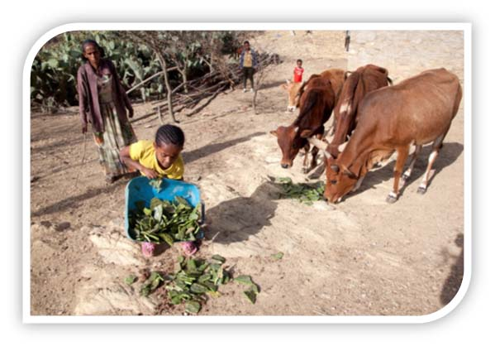
Mahlet helps her parents to look after their animals and to grow vegetables. They grow maize, sorghum, potatoes and tomatoes. They eat these vegetables and they sell them at the market.

Slide 24
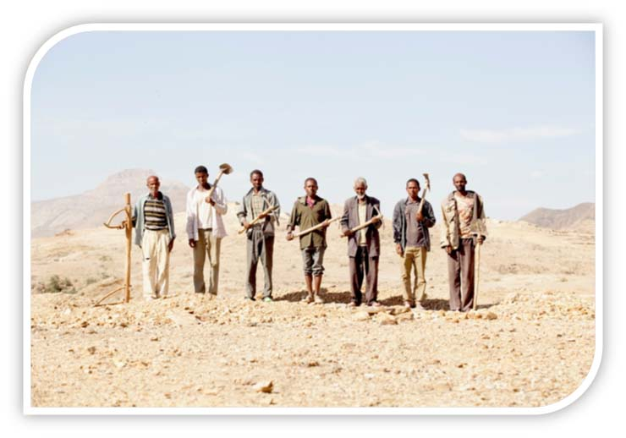
When Ali (Mahlet’s father) was a young boy there was enough rainfall to feed the vegetables. Now, because of climate change, there is not always enough rain for the crops to grow. These farmers are ready to farm, but the land is too dry.
Ali

Slide 25
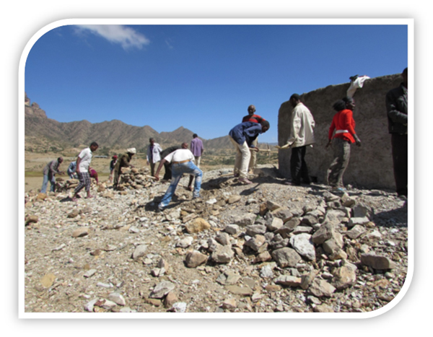
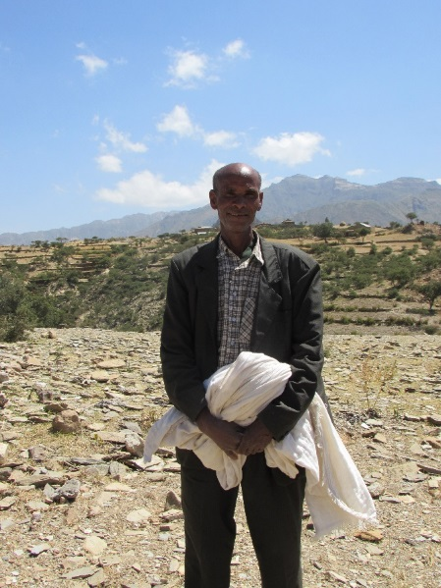
Trócaire is working with ADCS (Adigrat Diocese Catholic Secretariat), and the local community, to build an irrigation system. It will pump water from a place far away. This will help Ali and Mahlet to grow their vegetables.
Ali is the community leader who is organising the irrigation scheme. Everybody in the community will benefit from this.

Slide 26
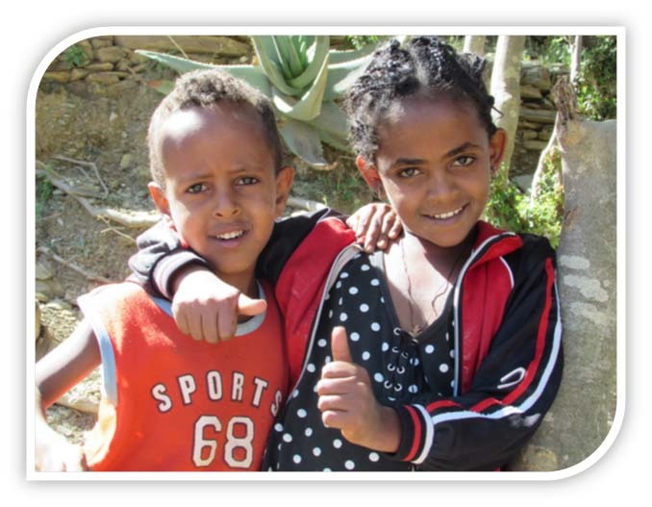
What similarities and differences are there between your life and Mahlet’s life?

Slide 27
Climate Injustice
Using your new knowledge on climate change in general, and Ethiopia in particular, can you suggest reasons why Mahlet’s community can be considered an example of climate injustice? Complete this exercise in small groups and then report back to the rest of the class.
Think about the causes and effects of climate change when coming up with your reasons!

Slide 28
Thank You!
Thank you very much for using our resources.
We hope you have learned a lot about climate change and climate justice.
Please check out our education website for more exciting resources on this subject.

