Slide 1
Ethiopia ‘Mahlet’s Homeland’

Slide 2
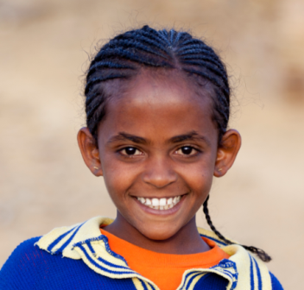
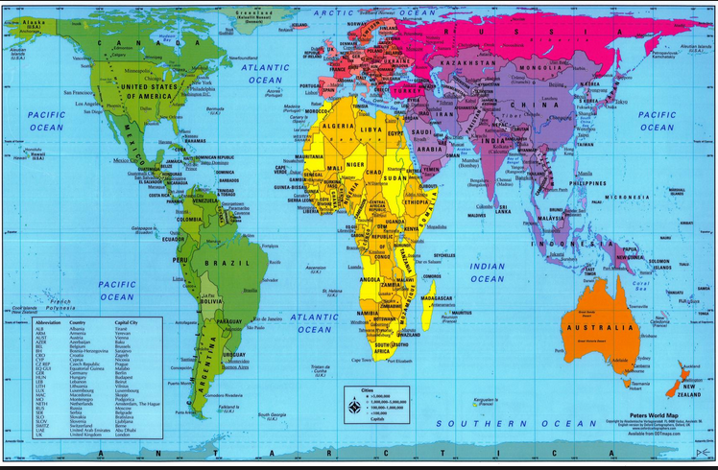
Meet Mahlet. She is 13 years old and lives in a country called Ethiopia. Can you find Ethiopia and Ireland on the world map?

Slide 3
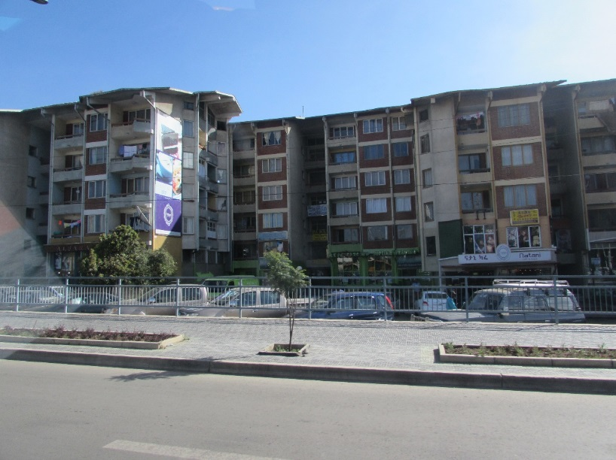
Addis Ababa is the capital of Ethiopia. Almost 4 million people live there. It is one of the highest cities in the world.

Slide 4
Mahlet lives in a rural community in the region of Tigray in northern Ethiopia.
Mahlet’s house

Slide 5
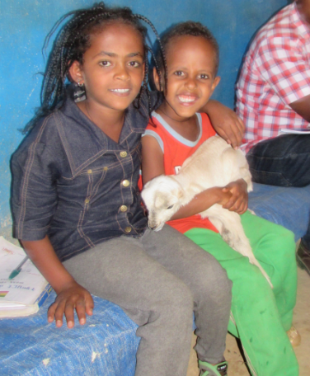
Mahlet lives with her mum and dad, sister, two brothers and nephew.
Shewit
Urkabel
Taemu
Ali
Mahlet
Samuel

Slide 6
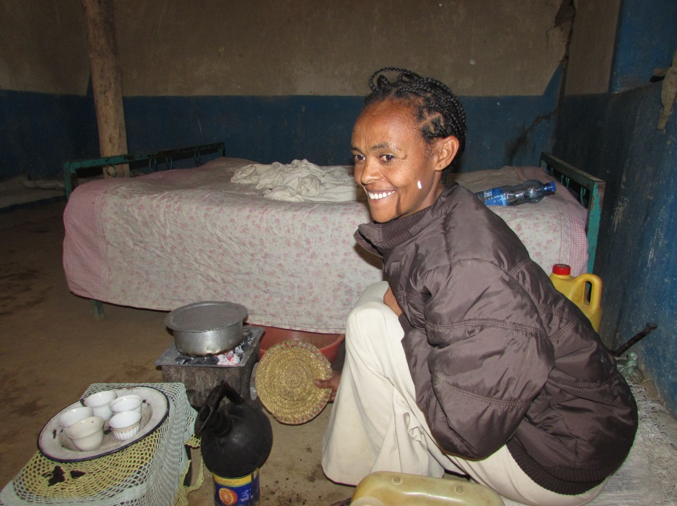
Shewit serves coffee and popcorn to guests who visit their house. This is an Ethiopian tradition. Coffee originally comes from Ethiopia.

Slide 7
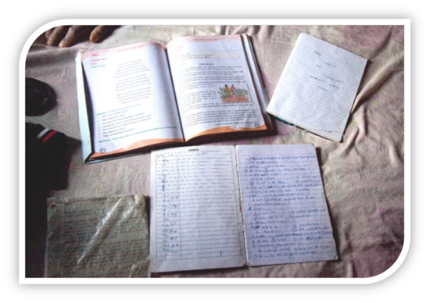
Mahlet enjoys school. Her favourite subject is English. She would like to be a doctor when she grows up.

Slide 8
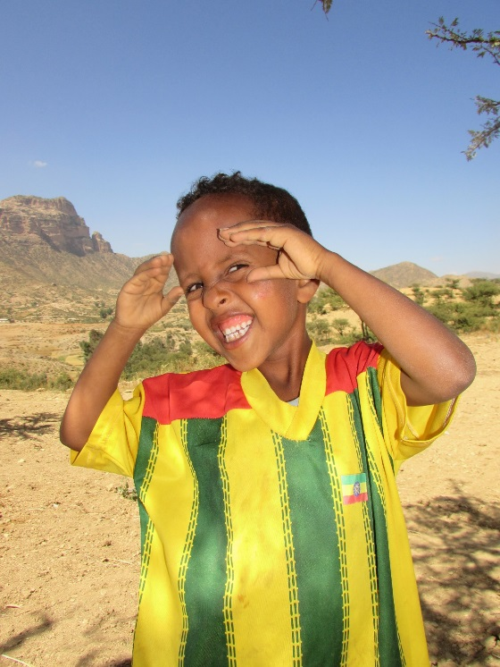
Mahlet loves to play ‘catch the stone’ with her friends. They throw a stone in the air. They must pick up as many new stones as they can before it falls on the ground.
Football is a popular sport in Ethiopia. This is the Ethiopian team jersey.

Slide 9
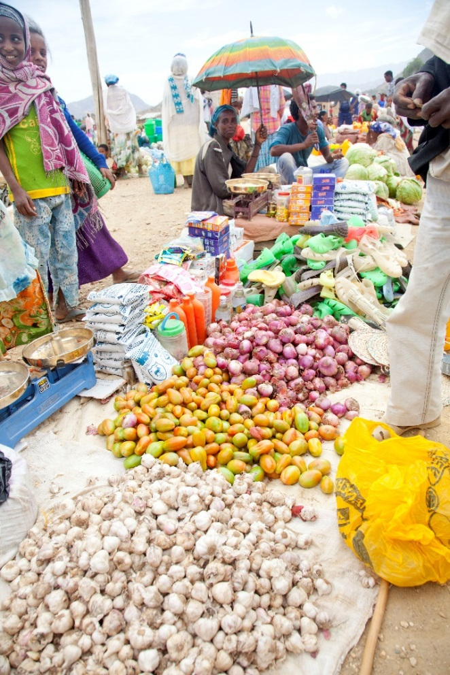
Mahlet helps her parents to look after their animals and to grow vegetables. They grow maize, sorghum, potatoes and tomatoes. They eat these vegetables and they sell them at the market.

Slide 10
When Ali (Mahlet’s father) was a young boy there was enough rainfall to feed the vegetables. Now, because of climate change, there is not always enough rain for the crops to grow. These farmers are ready to farm, but the land is too dry.
Ali

Slide 11
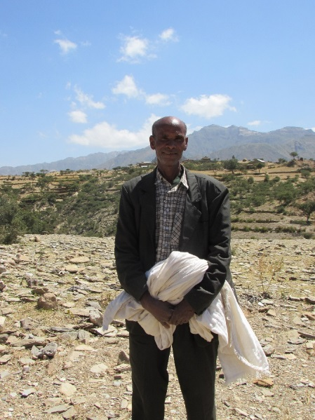
Trócaire is working with ADCS (Adigrat Diocese Catholic Secretariat), and the local community, to build an irrigation system. It will pump water from a place far away. This will help Ali and Mahlet to grow their vegetables.
Ali is the community leader who is organising the irrigation scheme. Everybody in the community will benefit from this.

Slide 12
What similarities and differences are there between your life and Mahlet’s life?

